Slide 1
The Battle of Neighborhoods
—— Where to open a restaurant in Toronto

Slide 2
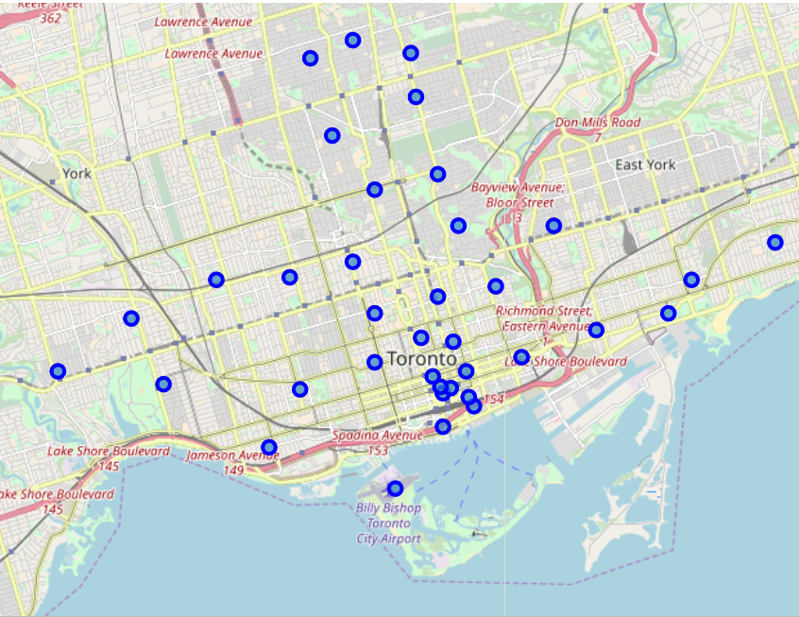
Introduction
?
In this project, we will discuss the problem that how to select a location if someone is looking to open a restaurant in Toronto, CA.
The target group who would be interested in this project is the restaurateur or the invertor.
The problem they are interested in could be summarized into that where the restaurant would locate to attract as many as customers.

Slide 3
Data Source
Neighbourhood information grouped by postal code is collected from WiKi page and then is processed.
Geographical coordinates of each neighbourhood can be assessed through .csv file offered in assignment of last week.
Trending Venues around each neighbourhood are acquired from FourSquare

Slide 4

Methodology
To address the problem that attracting as many as customers, we define a parameter "Score" to measure the geographical convenience of the restaurant to its target customer group.
$$Score=\sum{D_{i}∗{QD}_{i}}$$
D--distance
QD--quantity demanded
It represents the sum of product of the distance between the neighbourhood where the restaurant locates and other neibourhoods and quantity demanded of this kind of restaurant. The less the value is, the easier to be approached the restaurant is for its customers.
The distance can be calculated by geographical coordinates of each neighbourhood.
And the quantity demanded is represented by trending venues. The more frequently a type of restaurant appears, the greater its demand is in this neighbourhood.

Slide 5
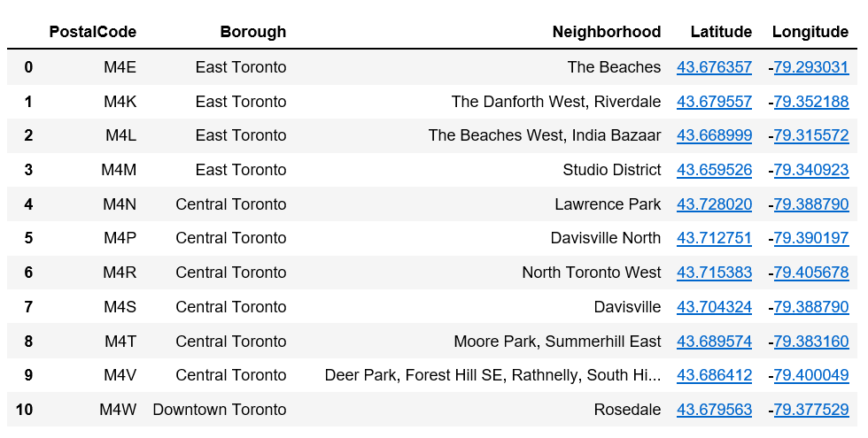
Methodology geographical data of each neighbourhood

Slide 6
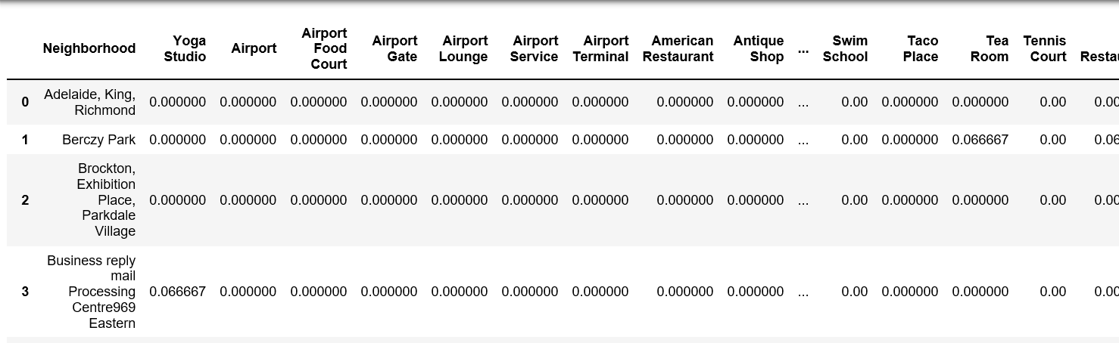
Methodology trending venues of each neighbourhood

Slide 7
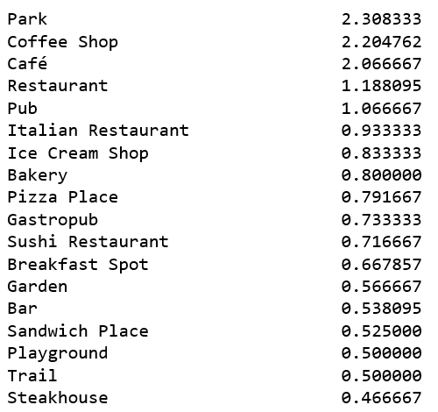
Methodology trending venues of each neighbourhood
Coffee Shop is highly demanded!

Slide 8
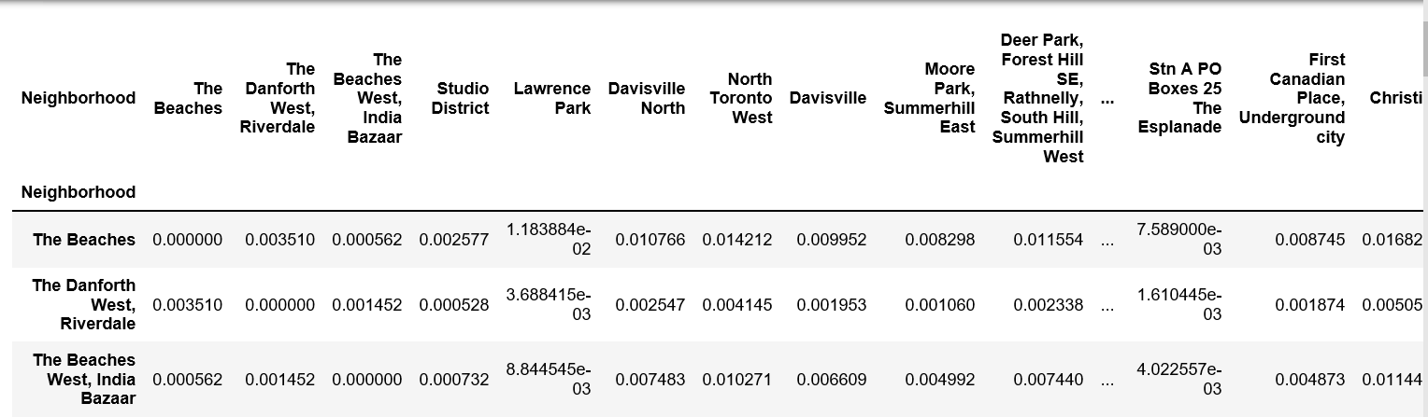
Methodology calculate distance between each two neighbourhood

Slide 9
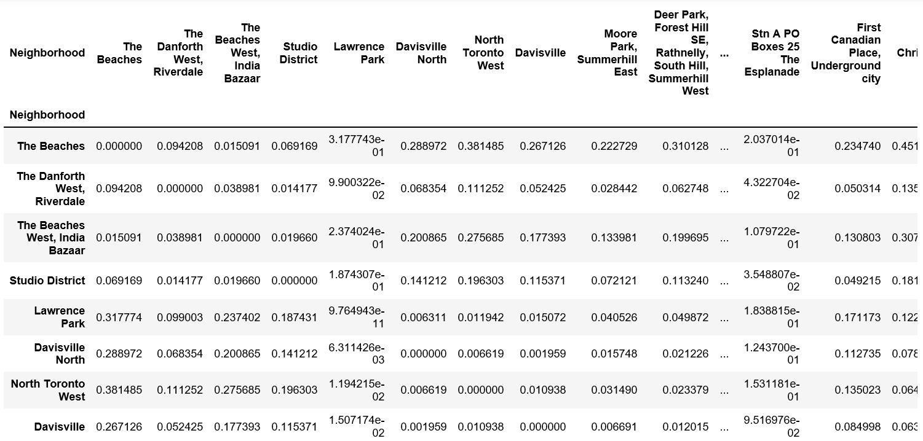
Methodology calculate distance between each two neighbourhood – after normalization

Slide 10
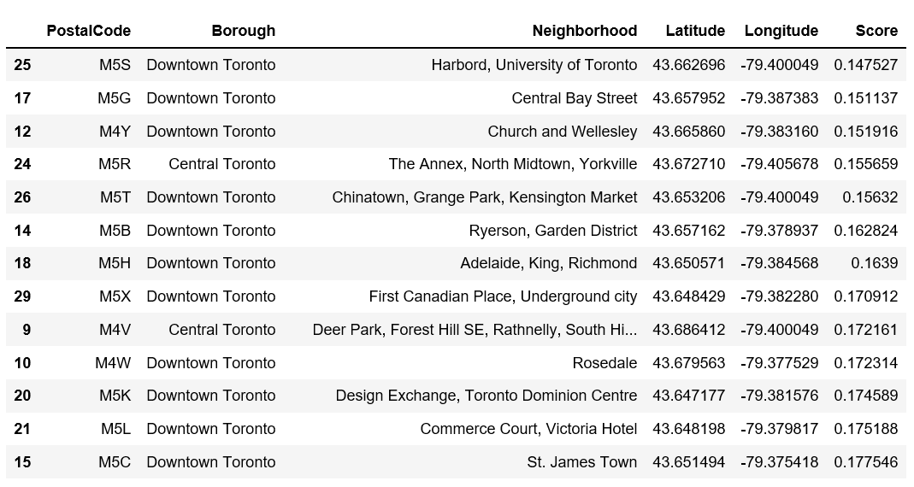
Methodology calculate Score of each neighbourhood and sort it

Slide 11
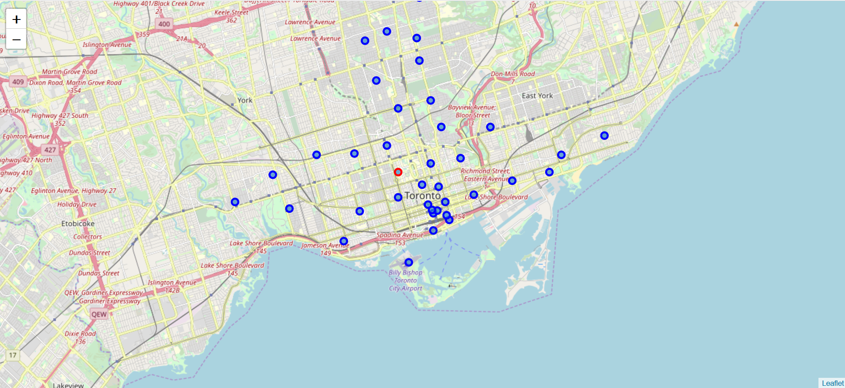
Methodology display the location in map
Just here! Open a Coffee Shop!

Slide 12
Results
Coffee shop appears frequently.
Neighborhood 'Harbord, University of Toronto' has lowest value (0.147527) in parameter 'Score' we define.

Slide 13
Disscusion
Coffee shop is the most popular type of restaurant. It also means larger quantity demanded.
To make all customers who like coffee shop assess it conveniently, the value of the parameter 'Score' should be as low as it could be. So we choose the Neighborhood 'Harbord, University of Toronto' to open a coffee shop as it has lowest value 0.147527.
It can be also shown that the Neighborhood 'Harbord, University of Toronto' locates in the center of Toronto, which makes customers from all other neighborhood easy to approach it.

Slide 14
Conclusion
According to analysis, we would recommend that you could open a coffee shop in the Neighborhood 'Harbord, University of Toronto'.

